Slide 1
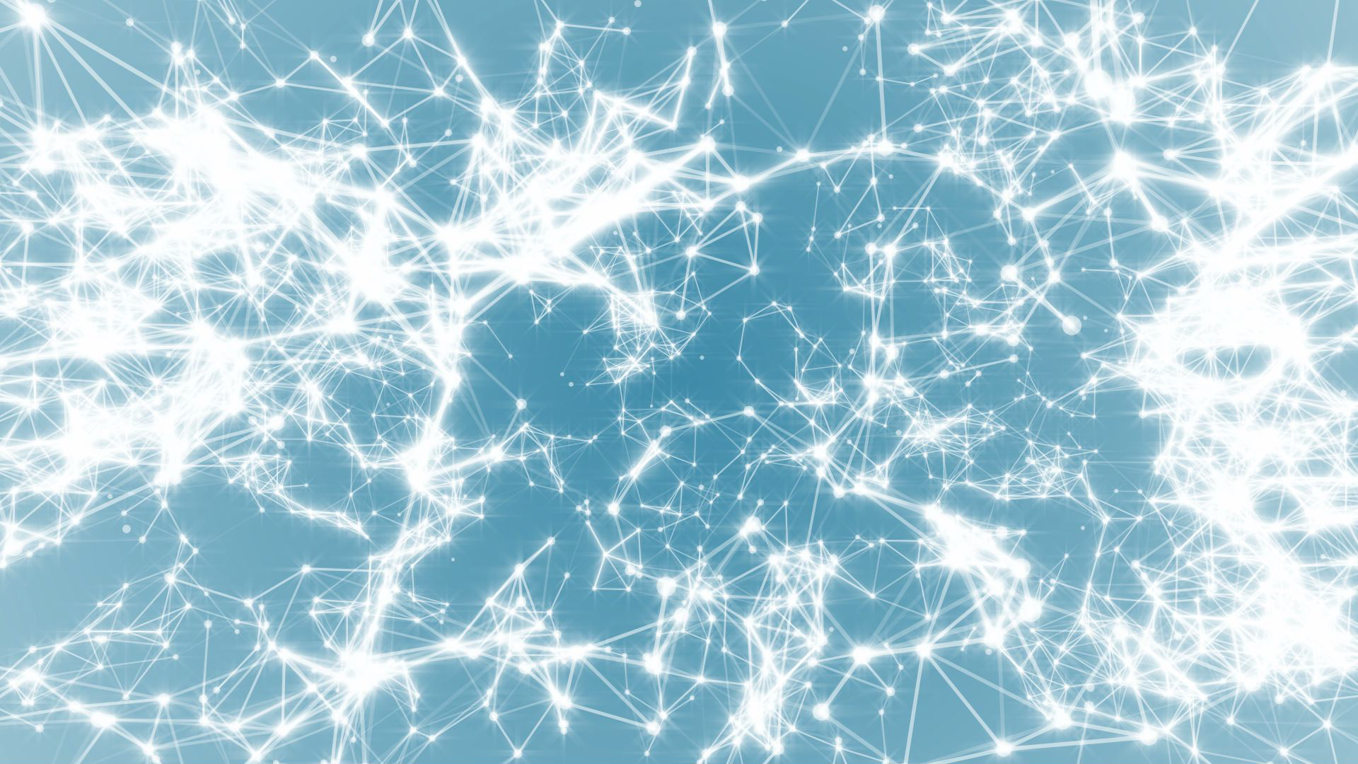
Network Science
Class 2: Graph Theory (Ch2)
Albert-László Barabási
with
Roberta Sinatra
www.BarabasiLab.com
Notes:
We all have our theories of the origin of this mess. And we may also differ in the way we would like to see the solutions. But we all agree on one thing– it is the incerconnectedness of the system that is at the heart to wash away the problem with a single instruction.

Slide 2
Section 1
The Bridges of Konigsberg

Slide 3
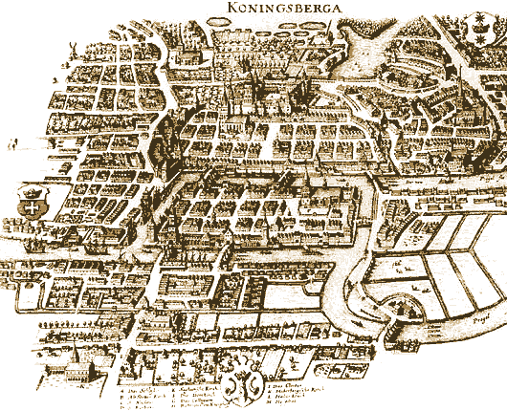
THE BRIDGES OF KONIGSBERG
Can one walk across the seven bridges and never cross the same bridge twice?
Network Science: Graph Theory
http://www.numericana.com/answer/graphs.htm
Notes:
Few research fields can trace their roots to a single moment and place in history. Graph theory, the mathematical scaffold behind network science, can. Its roots go back to 1736 to Konigsberg, a thriving merchant city in Eastern Prussia. Its busy fleet of ships and the trade they brought allowed city officials to build seven bridges across the river Pregel that surrounded the town. Five of these connected the elegant island Kneiphof, caught between the two branches of the Pregel, to the mainland;
two crossed the two branches of the river. This peculiar arrangement gave birth to a contemporary puzzle: Can one walk across all seven bridges and never cross the same one twice? Despite many attempts, no one could find such path. The problem remained unsolved until 1736, when Leonard Euler, a Swiss born mathematician, offered a rigorous mathematical proof that such path does not exist.

Slide 4
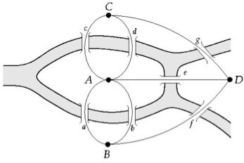
THE BRIDGES OF KONIGSBERG
Can one walk across the seven bridges and never cross the same bridge twice?
1735: Euler’s theorem:
If a graph has more than two nodes of odd degree, there is no path.
If a graph is connected and has no odd degree nodes, it has at least one path.
Network Science: Graph Theory
http://www.numericana.com/answer/graphs.htm
Notes:
Euler's insight was to represent each of the four land areas separated by the river as nodes, distinguishing them with letters A, B, C, and D. Next he connected with lines each piece of land that had a bridge between them. He thus built a {graph}, whose {nodes} were the pieces of land and {links} were the bridges. Then Euler made a simple observation: if there is a path crossing all bridges, but never the same bridge twice, then nodes with odd number of links must be either the starting or the end point of this path. Indeed, with an odd number of links you can arrive to a node and have no unused link for you to leave it. Yet, a continuous path that goes through all bridges can have only one starting and one end point. Thus such a path cannot exist on a graph that has more than two nodes with an odd number of links. As the K\"{o}nigsberg graph had three such nodes, B, C, D, each with three links, no path could satisfy the problem.
Today we remember Euler's proof because it was the first time someone solved a mathematical problem by turning it into a graph. In hindsight the proof has two important messages:
1. Some problems become simpler and more treatable if they are represented as a graph.
2. The existence of the path does not depend on our ingenuity to find it. Rather, it is a property of the graph. Indeed, given the layout of the K\"{o}nigsberg bridges, no matter how smart we are, we will never find the desired path.
in 1875 built a new bridge between B and C, increasing the number of links of these two nodes to four
In other words, networks have properties, hidden in their structure, that affect the function of the system they describe, limiting or enhancing our ability to do things with or on them. To fully understand how networks affect the properties of a system, we need to become familiar with some basic concepts in graph theory, encountering the language and mathematical formalism that will be of direct use throughout this book.

Slide 5
Section 2
Networks and graphs

Slide 6
COMPONENTS OF A COMPLEX SYSTEM
components: nodes, vertices N
interactions: links, edges L
system: network, graph (N,L)
Network Science: Graph Theory

Slide 7
NETWORKS OR GRAPHS?
network often refers to real systems
www,
social network
metabolic network.
Language: (Network, node, link)
graph: mathematical representation of a network
web graph,
social graph (a Facebook term)
Language: (Graph, vertex, edge)
We will try to make this distinction whenever it is appropriate, but in most cases we will use the two terms interchangeably.
Network Science: Graph Theory

Slide 8

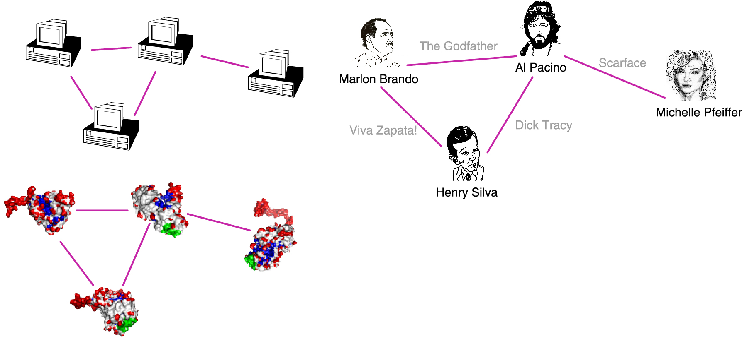
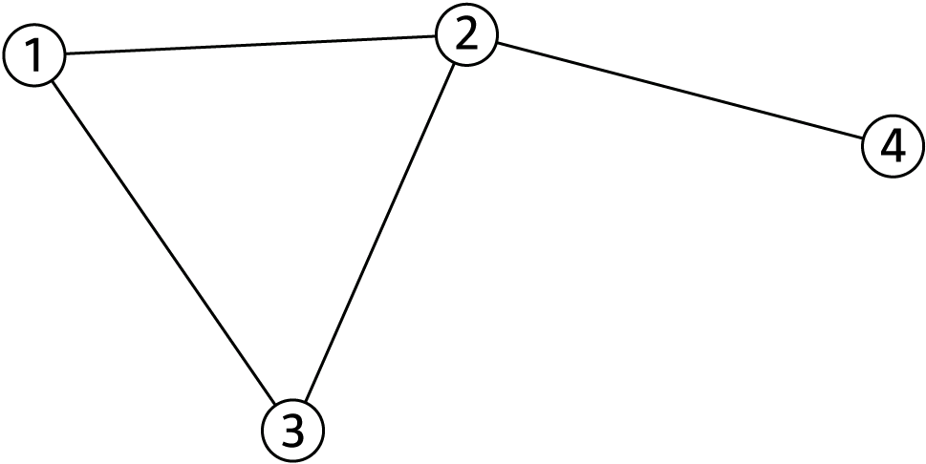
A COMMON LANGUAGE
N=4
L=4
Network Science: Graph Theory

Slide 9
CHOOSING A PROPER REPRESENTATION
The choice of the proper network representation determines our ability to use network theory successfully.
In some cases there is a unique, unambiguous representation.
In other cases, the representation is by no means unique.
For example, the way we assign the links between a group of individuals will determine the nature of the question we can study.
Network Science: Graph Theory

Slide 10
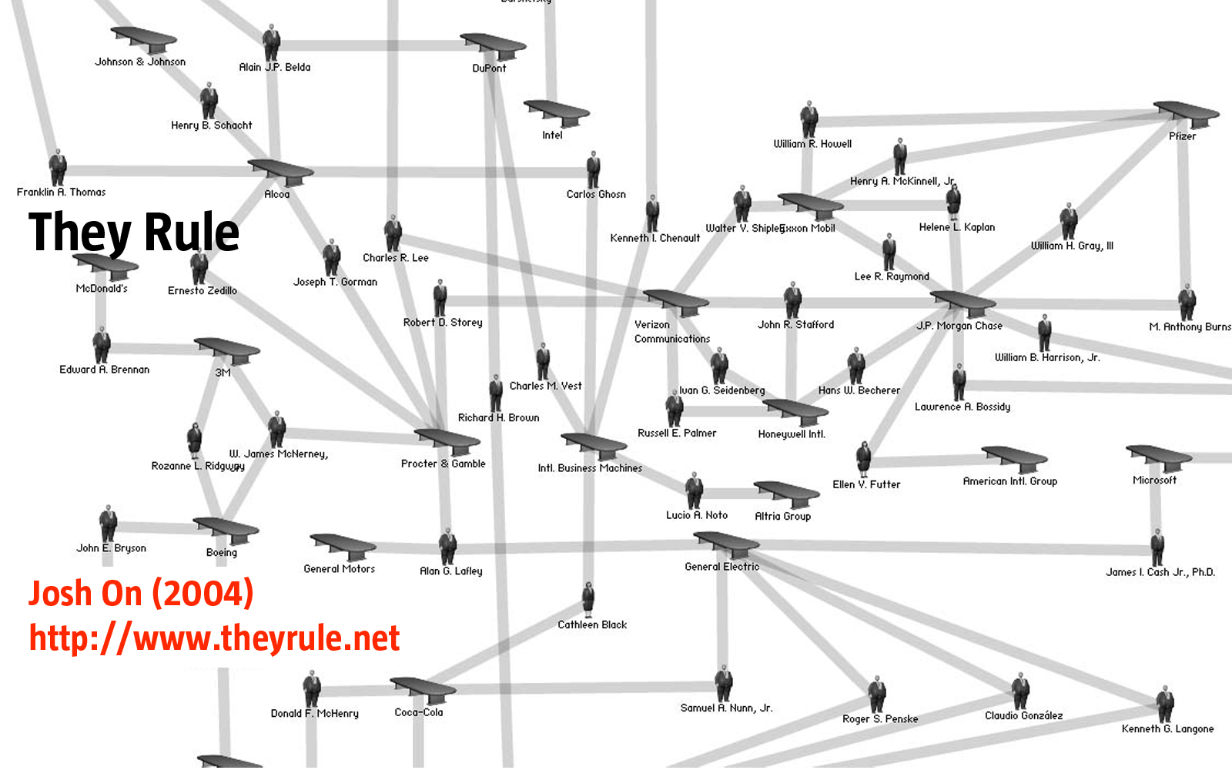
CHOOSING A PROPER REPRESENTATION
If you connect individuals that work with each other, you will explore
the professional network.
Network Science: Graph Theory

Slide 11
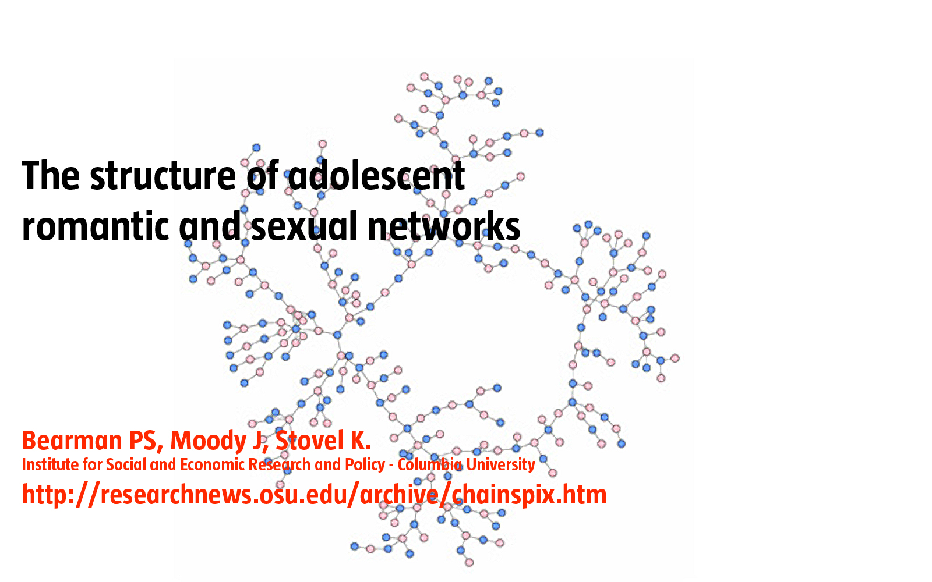
CHOOSING A PROPER REPRESENTATION
If you connect those that have a romantic and sexual relationship, you will be exploring the sexual networks.
Network Science: Graph Theory

Slide 12
CHOOSING A PROPER REPRESENTATION
If you connect individuals based on their first name (all Peters connected to each other), you will be exploring what?
It is a network, nevertheless.
Network Science: Graph Theory

Slide 13
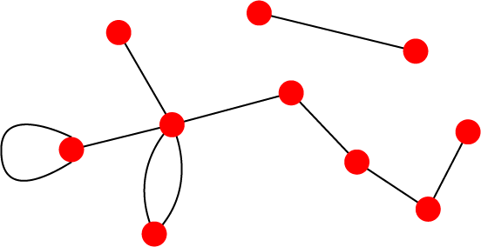
UNDIRECTED VS. DIRECTED NETWORKS
Undirected
Directed
Links: undirected (symmetrical)
Graph:
Links: directed (arcs).
Digraph = directed graph:
L
A
D
F
M
B
An undirected link is the superposition of two opposite directed links.
C
I
D
B
G
E
G
H
A
C
F
Undirected links :
coauthorship links
Actor network
protein interactions
Directed links :
URLs on the www
phone calls
metabolic reactions
Network Science: Graph Theory
Notes:
A key property of each node is its degree, representing the number of links it has to other nodes. The degree can represent the number of mobile phone contacts an individual has in the call graph (i.e. the number of different indivi uals the person has talked to), or the number of citations a research paper gets in the citation network.
We denote with ki the degree of the ith node in the network.

Slide 14
Section 2.2 Reference Networks

Slide 15
Section 2.3
Degree, Average Degree and Degree Distribution

Slide 16
NODE DEGREES
Node degree: the number of links connected to the node.
A
Undirected
B
In directed networks we can define an in-degree and out-degree. The (total) degree is the sum of in- and out-degree.
Source: a node with k^{in}= 0; Sink: a node with k^{out}= 0.
B
D
Directed
C
G
E
A
F
Notes:
A key property of each node is its degree, representing the number of links it has to other nodes. The degree can represent the number of mobile phone contacts an individual has in the call graph (i.e. the number of different indivi uals the person has talked to), or the number of citations a research paper gets in the citation network.
We denote with ki the degree of the ith node in the network.

Slide 17
A BIT OF STATISTICS
Network Science: Graph Theory

Slide 18
AVERAGE DEGREE
Undirected
j
i
N – the number of nodes in the graph
B
D
Directed
C
E
A
F
Network Science: Graph Theory

Slide 19
Average Degree
Network Science: Graph Theory

Slide 20
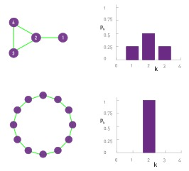

DEGREE DISTRIBUTION
Degree distribution
P(k): probability that a
randomly chosen node
has degree k
Nk = # nodes with degree k
P(k) = Nk / N ➔ plot

Slide 21
DEGREE DISTRIBUTION
Notes:
In many real networks, the node degree can vary considerably.
For example, as the degree distribution (a) indicates, the degrees of the proteins in the protein interaction network shown in (b) vary between k=0 (isolated nodes) and k=92, which is the degree of the largest node, called a hub. There are also wide differences in the number of nodes with different degrees: as (a) shows, almost half of the nodes have degree one (i.e. p1=0.48), while there is only one copy of the biggest node, hence p92 = 1/ N=0.0005. (c) The degree distribution is often shown on a so-called log- log plot, in which we either plot log pk in function of log k, or, as we did in (c), we use logarithmic axes.

Slide 22
DEGREE DISTRIBUTION
Discrete Representation: p_{k} is the probability that a node has degree k.
Continuum Description: p(k) is the pdf of the degrees, where
represents the probability that a node’s degree is between k₁ and k₂.
Normalization condition:
where K_{min} is the minimal degree in the network.
Network Science: Graph Theory

Slide 23
Section 2.4
Adjacency matrix

Slide 24
ADJACENCY MATRIX
4
4
3
2
3
2
1
1
A_{ij}=1 if there is a link between node i and j
A_{ij}=0 if nodes i and j are not connected to each other.
Note that for a directed graph (right) the matrix is not symmetric.
if there is a link pointing from node j and i
if there is no link pointing from j to i.
Network Science: Graph Theory

Slide 25
ADJACENCY MATRIX AND NODE DEGREES
4
Undirected
2
3
1
Directed
4
2
3
1

Slide 26
ADJACENCY MATRIX
a
e
a b c d e f g h
a 0 1 0 0 1 0 1 0
b 1 0 1 0 0 0 0 1
c 0 1 0 1 0 1 1 0
d 0 0 1 0 1 0 0 0
e 1 0 0 1 0 0 0 0
f 0 0 1 0 0 0 1 0
g 1 0 1 0 0 0 0 0
h 0 1 0 0 0 0 0 0
h
b
d
f
g
c
Network Science: Graph Theory
Notes:
The adjacency matrix can take far more complicated forms for a larger network….

Slide 27
Section 4
Real networks are sparse

Slide 28
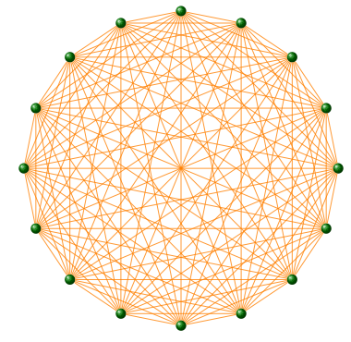
COMPLETE GRAPH
The maximum number of links a network
of N nodes can have is:
A graph with degree L=L_{max} is called a complete graph,
and its average degree is <k>=N-1
Network Science: Graph Theory

Slide 29
REAL NETWORKS ARE SPARSE
Most networks observed in real systems are sparse:
L << L_{max}
or
<k> <<N-1.
WWW (ND Sample): N=325,729; L=1.4 10⁶ L_{max}=10¹² <k>=4.51
Protein (S. Cerevisiae): N= 1,870; L=4,470 L_{max}=10⁷ <k>=2.39
Coauthorship (Math): N= 70,975; L=2 10⁵ L_{max}=3 10¹⁰ <k>=3.9
Movie Actors: N=212,250; L=6 10⁶ L_{max}=1.8 10¹³ <k>=28.78
(Source: Albert, Barabasi, RMP2002)
Network Science: Graph Theory

Slide 30
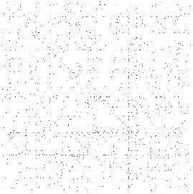
ADJACENCY MATRICES ARE SPARSE
Network Science: Graph Theory
Notes:
The adjacency matrix of the yeast protein-protein interaction network, consisting of 2,018 nodes, each representing a yeast protein (Table 2.1). A dot is placed on each spot of the adjacent matrix for which Aij = 1, indicating the presence of an interaction. There are no dots for Aij = 0. The small fraction of dots underlines the sparse nature of the protein-protein interaction network.

Slide 31
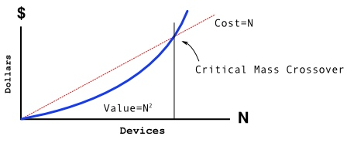
METCALFE’S LAW
The maximum number of links a network
of N nodes can have is:
Network Science: Graph Theory
Notes:
Metcalfe's law, frequently quoted during the internet boom of 2000, states that the value of a network is proportional to the square of the number of its nodes, i.e. $N^2$. Formulated around 1980 in terms of communication devices by Robert M. Metcalfe, the inventor of Ethernet\cite{Gilder_Forbes-ASAP_1993}, the idea behind Metcalfe's law is that the more individuals use a network, the more valuable it becomes. Indeed, a fax machine is useless to you if there is no one to send a fax to. The more of your acquaintances have a fax machine, the more valuable it is to you as well. The $N^2$ dependence encodes the fact that if a network has $N=10$ members, there are $L_{max}=45$ different possible connections that these members can make to each other. If the network doubles in size to $N=20$, the number of connections doesn't merely double but roughly quadruples to 190, an effect often called "network effect" or "network externality" in economics.
During the Internet boom Metcalfe's law was frequently used to offer a quantitative valuation for internet companies, supporting a "build it and they will come " mentality\cite{Briscoe_Spectrum-IEEE_2006}. It implied that the value of a service is proportional to the square of the number of its consumers or users, while costs would grow only linearly. Hence if the service attracts sufficient number of users, it will inevitably become profitable, as $N^2$ will surely surpass $N$ at some sufficiently large $N$ value. Hence Metcalf's Law offered credibility to growth, while neglecting profitability, fueling the Internet bubble of 2001.
Metcalfe's law imagines that networks are complete graphs. It is based on Eq. (\ref{EQ-L-Max}), indicating that if all links of communication network with $N$ nodes are equally valuable, the total value of the network is proportional to $N(N-1)/2$, that is, roughly, $N^2$.
There are two fundamental problems with Metcalfe's law:
While all links are possible, in real networks not all links are present. Indeed, most real networks are sparse, which means that only a very small fraction of the links are present. If we assign a value to each link, then the total value of the network will grow slower than $N^2$, as we will see in the coming chapters.
Not all links are of equal value. Some links are used heavily while the vast majority of links are 'weak', i.e. they are rarely utilized.

Slide 32
Section 2.6
WEIGHTED AND UNWEIGHTED NETWORKS

Slide 33
WEIGHTED AND UNWEIGHTED NETWORKS

Slide 34
METCALFE’S LAW
The maximum number of links a network
of N nodes can have is:
Network Science: Graph Theory
Notes:
Metcalfe's law, frequently quoted during the internet boom of 2000, states that the value of a network is proportional to the square of the number of its nodes, i.e. $N^2$. Formulated around 1980 in terms of communication devices by Robert M. Metcalfe, the inventor of Ethernet\cite{Gilder_Forbes-ASAP_1993}, the idea behind Metcalfe's law is that the more individuals use a network, the more valuable it becomes. Indeed, a fax machine is useless to you if there is no one to send a fax to. The more of your acquaintances have a fax machine, the more valuable it is to you as well. The $N^2$ dependence encodes the fact that if a network has $N=10$ members, there are $L_{max}=45$ different possible connections that these members can make to each other. If the network doubles in size to $N=20$, the number of connections doesn't merely double but roughly quadruples to 190, an effect often called "network effect" or "network externality" in economics.
During the Internet boom Metcalfe's law was frequently used to offer a quantitative valuation for internet companies, supporting a "build it and they will come " mentality\cite{Briscoe_Spectrum-IEEE_2006}. It implied that the value of a service is proportional to the square of the number of its consumers or users, while costs would grow only linearly. Hence if the service attracts sufficient number of users, it will inevitably become profitable, as $N^2$ will surely surpass $N$ at some sufficiently large $N$ value. Hence Metcalf's Law offered credibility to growth, while neglecting profitability, fueling the Internet bubble of 2001.
Metcalfe's law imagines that networks are complete graphs. It is based on Eq. (\ref{EQ-L-Max}), indicating that if all links of communication network with $N$ nodes are equally valuable, the total value of the network is proportional to $N(N-1)/2$, that is, roughly, $N^2$.
There are two fundamental problems with Metcalfe's law:
While all links are possible, in real networks not all links are present. Indeed, most real networks are sparse, which means that only a very small fraction of the links are present. If we assign a value to each link, then the total value of the network will grow slower than $N^2$, as we will see in the coming chapters.
Not all links are of equal value. Some links are used heavily while the vast majority of links are 'weak', i.e. they are rarely utilized.

Slide 35
Section 2.7
BIPARTITE NETWORKS

Slide 36
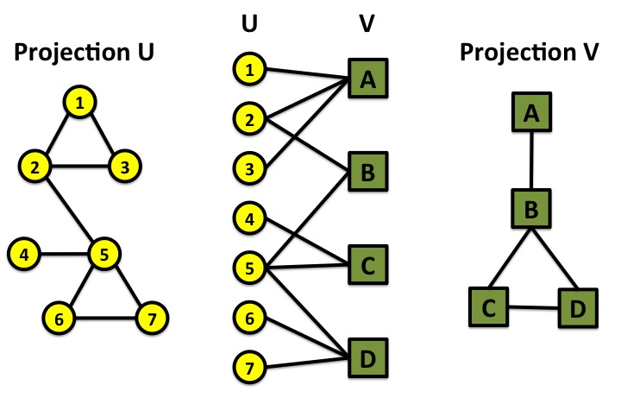
BIPARTITE GRAPHS
bipartite graph (or bigraph) is a graph whose nodes can be divided into two disjoint sets U and V such that every link connects a node in U to one in V; that is, U and V are independent sets.
Examples:
Hollywood actor network
Collaboration networks
Disease network (diseasome)
Network Science: Graph Theory

Slide 37
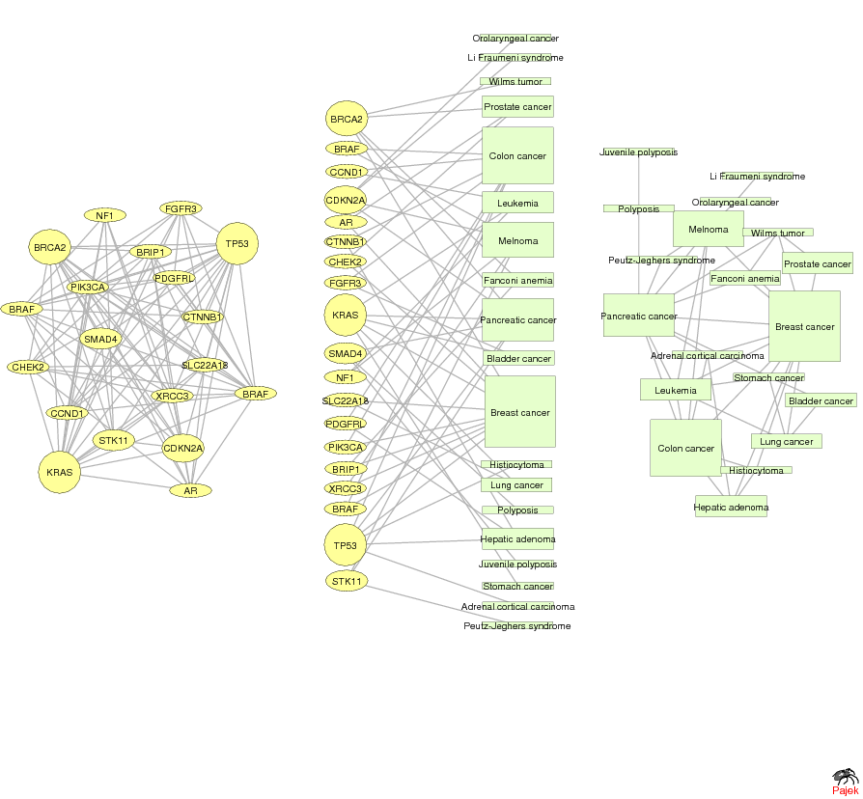
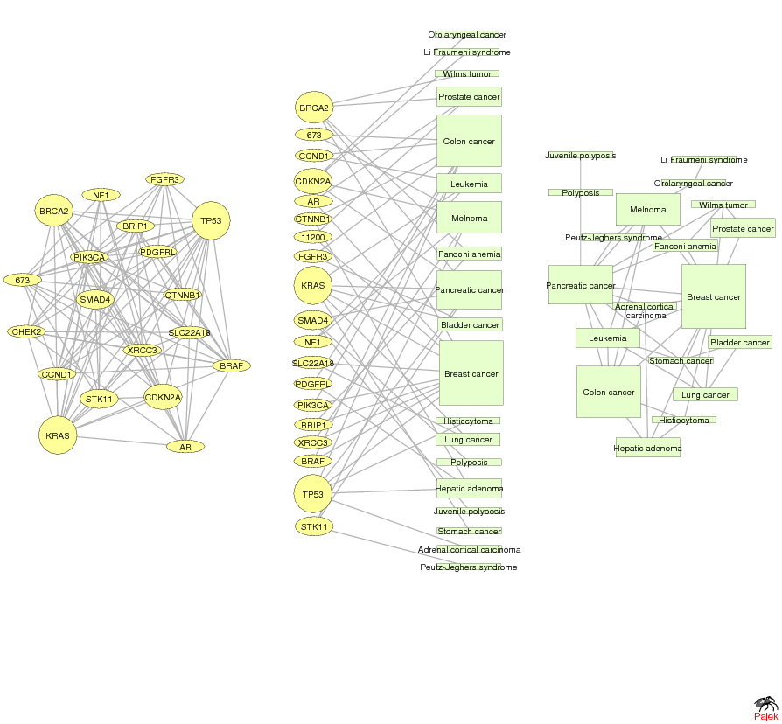
GENE NETWORK – DISEASE NETWORK
DISEASOME
PHENOME
GENOME
Gene network
Disease network
Goh, Cusick, Valle, Childs, Vidal & Barabási, PNAS (2007)
Network Science: Graph Theory

Slide 38
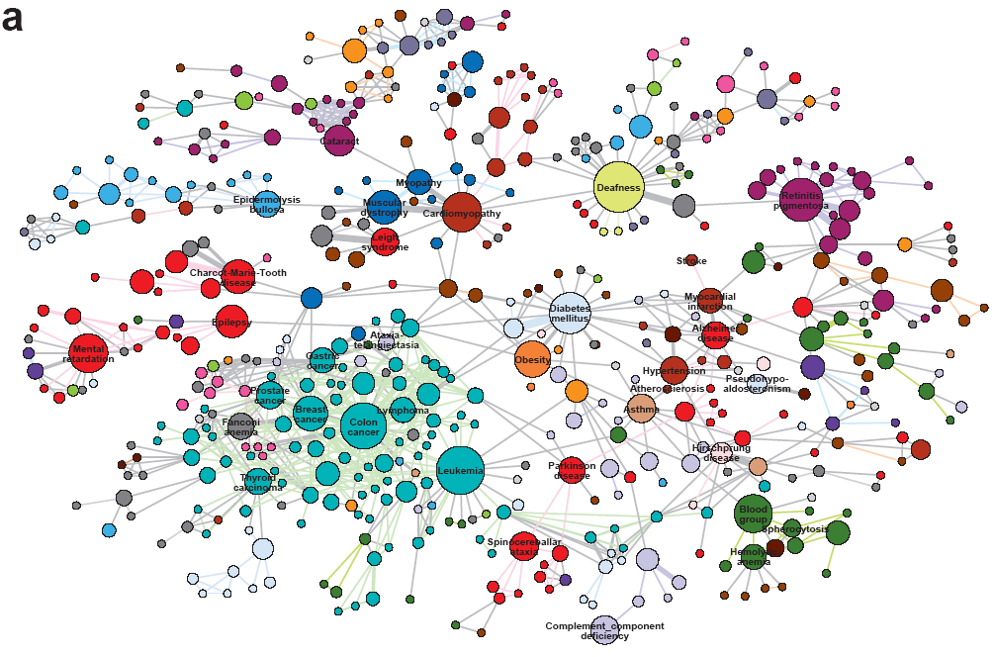
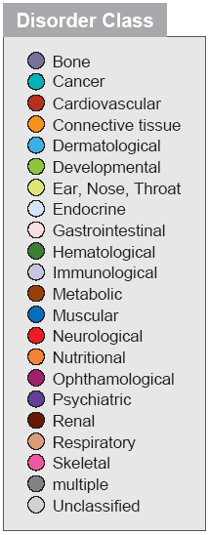
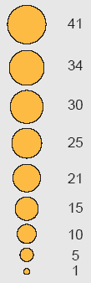
HUMAN DISEASE NETWORK

Slide 39
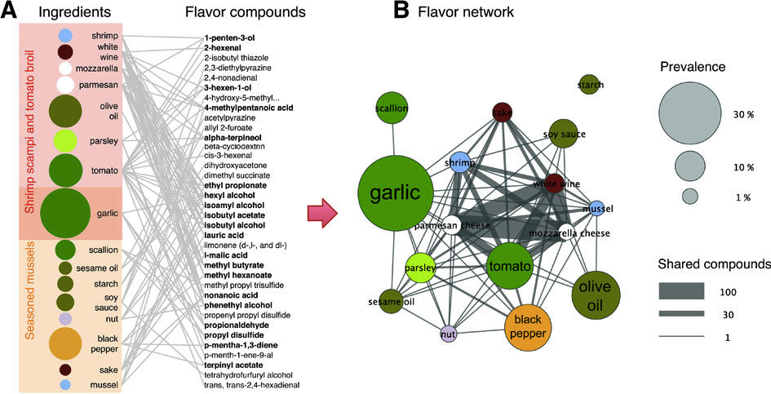
Ingredient-Flavor Bipartite Network
Y.-Y. Ahn, S. E. Ahnert, J. P. Bagrow, A.-L. Barabási Flavor network and the principles of food pairing , Scientific Reports 196, (2011).
Network Science: Graph Theory

Slide 40
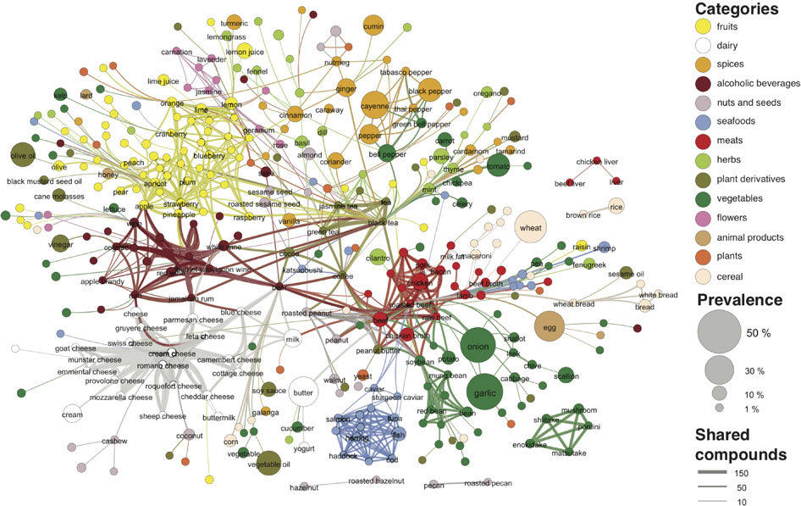

Slide 41
Section 2.8
PATHOLOGY

Slide 42
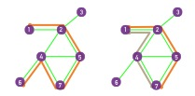
PATHS
A path is a sequence of nodes in which each node is adjacent to the next one
P_{i0,in} of length n between nodes i₀ and i_{n} is an ordered collection of n+1 nodes and n links
In a directed network, the path can follow only the direction of an arrow.
Network Science: Graph Theory

Slide 43
DISTANCE IN A GRAPH Shortest Path, Geodesic Path
The distance (shortest path, geodesic path) between two nodes is defined as the number of edges along the shortest path connecting them.
*If the two nodes are disconnected, the distance is infinity.
In directed graphs each path needs to follow the direction of the arrows.
Thus in a digraph the distance from node A to B (on an AB path) is generally different from the distance from node B to A (on a BCA path).
B
A
C
D
B
A
C
D
Network Science: Graph Theory

Slide 44
NUMBER OF PATHS BETWEEN TWO NODES Adjacency Matrix
N_{ij},number of paths between any two nodes i and j:
Length n=1: If there is a link between i and j, then A_{ij}=1 and A_{ij}=0 otherwise.
Length n=2: If there is a path of length two between i and j, then A_{ik}A_{kj}=1, and A_{ik}A_{kj}=0 otherwise.
The number of paths of length 2:
Length n: In general, if there is a path of length n between i and j, then A_{ik}…A_{lj}=1 and A_{ik}…A_{lj}=0 otherwise.
The number of paths of length n between i and j is*
*holds for both directed and undirected networks.
Network Science: Graph Theory

Slide 45
FINDING DISTANCES: BREADTH FIRST SEARCH
Distance between node 0 and node 4:
Start at 0.
1
1
1
3
3
4
1
2
4
3
2
1
1
1
3
0
4
2
4
3
3
4
1
4
3
4
4
2
2
3
Network Science: Graph Theory
Network Science: Graph Theory
Network Science: Graph Theory

Slide 46
FINDING DISTANCES: BREADTH FIRST SEARCH
Distance between node 0 and node 4:
Start at 0.
Find the nodes adjacent to 1. Mark them as at distance 1. Put them in a queue.
3
3
4
2
4
2
1
3
1
1
0
1
3
1
4
2
4
3
3
4
1
1
4
3
4
4
2
2
3
Network Science: Graph Theory
Network Science: Graph Theory

Slide 47
FINDING DISTANCES: BREADTH FIRST SEARCH
Distance between node 0 and node 4:
Start at 0.
Find the nodes adjacent to 0. Mark them as at distance 1. Put them in a queue.
Take the first node out of the queue. Find the unmarked nodes adjacent to it in the graph. Mark them with the label of 2. Put them in the queue.
3
3
4
2
2
4
2
1
3
3
2
1
1
1
4
1
0
1
2
2
4
3
3
4
1
1
1
4
3
4
4
2
2
2
2
3
Network Science: Graph Theory
Network Science: Graph Theory
Network Science: Graph Theory

Slide 48
FINDING DISTANCES: BREADTH FIRST SEARCH
Distance between node 0 and node 4:
Repeat until you find node 4 or there are no more nodes in the queue.
The distance between 0 and 4 is the label of 4 or, if 4 does not have a label, infinity.
3
3
4
2
4
3
2
1
0
1
3
4
2
4
3
3
4
1
4
3
4
4
2
2
3
Network Science: Graph Theory

Slide 49
NETWORK DIAMETER AND AVERAGE DISTANCE
Diameter: d_{max} the maximum distance between any pair of nodes in the graph.
Average path length/distance, <d>, for a connected graph:
where d_{ij} is the distance from node i to node j
In an undirected graph d_{ij} =d_{ji} , so we only need to count them once:
Network Science: Graph Theory

Slide 50
PATHOLOGY: summary
Shortest Path
1
2
5
3
4
The path with the shortest length between two nodes (distance).
Network Science: Graph Theory

Slide 51
PATHOLOGY: summary
Diameter
Average Path Length
1
1
2
5
2
5
3
4
3
4
The longest shortest path in a graph
The average of the shortest paths for all pairs of nodes.
Network Science: Graph Theory

Slide 52
PATHOLOGY: summary
Cycle
Self-avoiding Path
1
1
2
5
2
5
3
4
3
4
A path with the same start and end node.
A path that does not intersect itself.
Network Science: Graph Theory

Slide 53
PATHOLOGY: summary
Eulerian Path
Hamiltonian Path
1
1
2
5
2
5
3
4
3
4
A path that traverses each link exactly once.
A path that visits each node exactly once.
Network Science: Graph Theory

Slide 54
Section 2.9
CONNECTEDNESS

Slide 55
CONNECTIVITY OF UNDIRECTED GRAPHS
Connected (undirected) graph: any two vertices can be joined by a path.
A disconnected graph is made up by two or more connected components.
B
B
A
Largest Component:
Giant Component
A
F
C
D
F
C
D
F
The rest: Isolates
F
G
G
Bridge: if we erase it, the graph becomes disconnected.
Network Science: Graph Theory
Notes:
The phone is useless as a communication device if con not call any user with a valid number. Similarly, the Internet is useless as a communication system if you cannot send a message to any other user that has access to it. From a network perspective this means that that the technology behind the phone must be able to establish a path between your device and the device you are calling and that there needs to exist a path on the internet between any two computers with Internet access.
This is infact the key utility of most networks: they connect the system's components. This does not require a direct link between any two nodes, but only the existence of a path between them. These paths play an essential role in most network effects and the essence of a network is to guarantee connectedness. In this section we discuss the graph theoretic formulation of the connectedness problem.

Slide 56
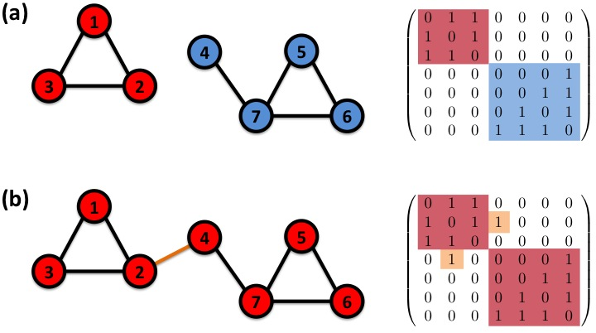
CONNECTIVITY OF UNDIRECTED GRAPHS Adjacency Matrix
The adjacency matrix of a network with several components can be written in a block-diagonal form, so that nonzero elements are confined to squares, with all other elements being zero:
Network Science: Graph Theory

Slide 57
CONNECTIVITY OF DIRECTED GRAPHS
Strongly connected directed graph: has a path from each node to
every other node and vice versa (e.g. AB path and BA path).
Weakly connected directed graph: it is connected if we disregard the
edge directions.
Strongly connected components can be identified, but not every node is part
of a nontrivial strongly connected component.
B
E
A
B
F
A
D
E
C
D
C
G
F
G
In-component: nodes that can reach the scc,
Out-component: nodes that can be reached from the scc.
Network Science: Graph Theory

Slide 58
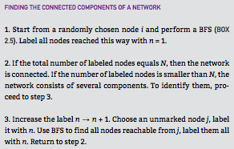
Section 2.9

Slide 59
Section 10
Clustering coefficient

Slide 60
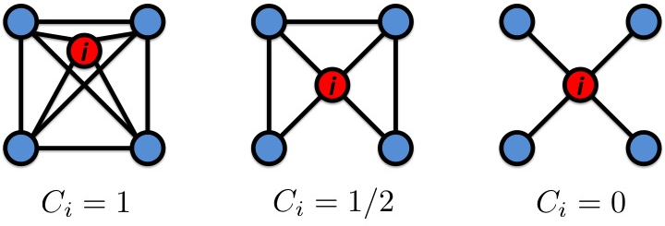
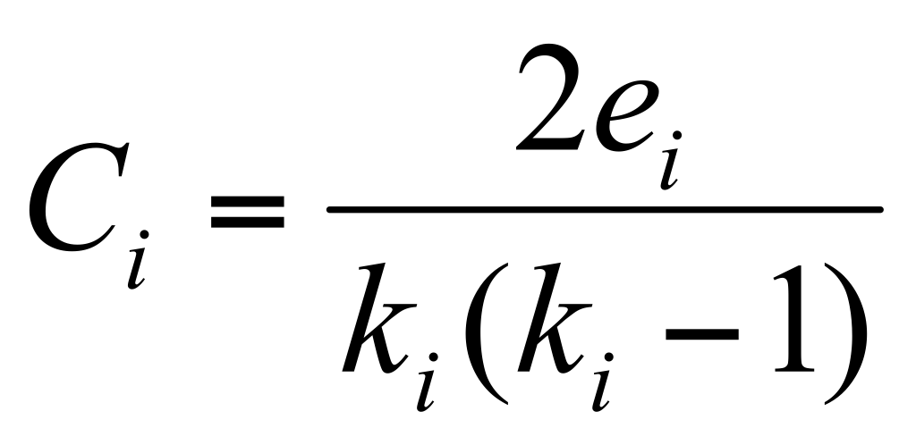
CLUSTERING COEFFICIENT
Clustering coefficient:
what fraction of your neighbors are connected?
Node i with degree ki
Ci in [0,1]
Watts & Strogatz, Nature 1998.
Network Science: Graph Theory

Slide 61
CLUSTERING COEFFICIENT
Clustering coefficient:
what fraction of your neighbors are connected?
Node i with degree ki
Ci in [0,1]
Watts & Strogatz, Nature 1998.
Network Science: Graph Theory

Slide 62
Section 11
summary

Slide 63
THREE CENTRAL QUANTITIES IN NETWORK SCIENCE
Degree distribution: P(k)
Path length: <d>
Clustering coefficient:
Network Science: Graph Theory

Slide 64
GRAPHOLOGY
1
Undirected
Directed
4
4
1
1
2
2
3
3
Actor network, protein-protein interactions
WWW, citation networks
Network Science: Graph Theory

Slide 65
GRAPHOLOGY
2
Unweighted
(undirected)
Weighted
(undirected)
4
4
1
1
2
2
3
3
protein-protein interactions, www
Call Graph, metabolic networks
Network Science: Graph Theory

Slide 66
GRAPHOLOGY
3
Self-interactions
Multigraph
(undirected)
4
4
1
1
2
2
3
3
Protein interaction network, www
Social networks, collaboration networks
Network Science: Graph Theory

Slide 67
GRAPHOLOGY
4
Complete Graph
(undirected)
4
1
2
3
Actor network, protein-protein interactions
Network Science: Graph Theory

Slide 68
GRAPHOLOGY: Real networks can have multiple characteristics
WWW > directed multigraph with self-interactions
Protein Interactions > undirected unweighted with self-interactions
Collaboration network > undirected multigraph or weighted.
Mobile phone calls > directed, weighted.
Facebook Friendship links > undirected, unweighted.
Network Science: Graph Theory

Slide 69
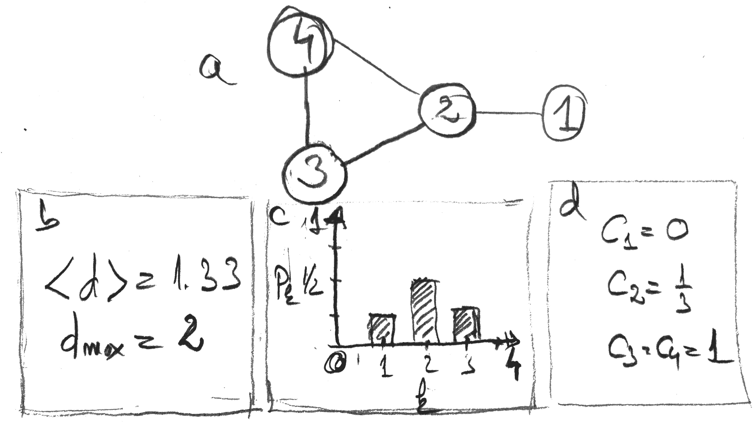
THREE CENTRAL QUANTITIES IN NETWORK SCIENCE
A. Degree distribution: p_{k}
B. Path length: <d>
C. Clustering coefficient:
Network Science: Graph Theory

Slide 70
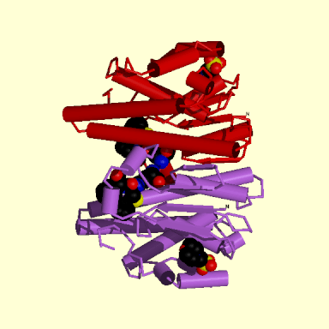
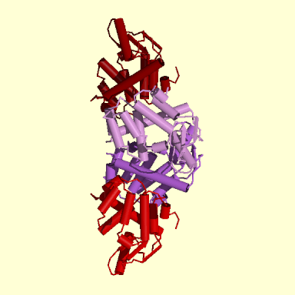
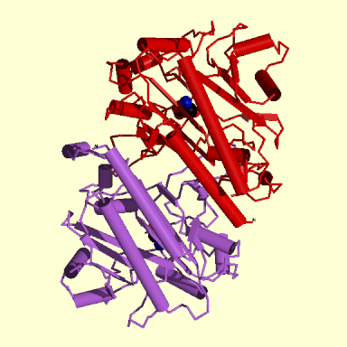
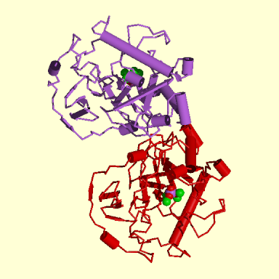
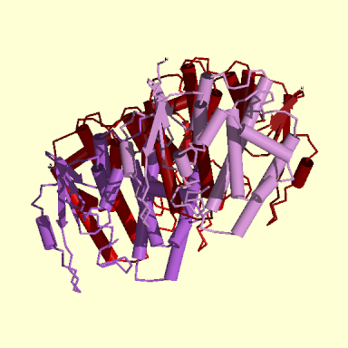
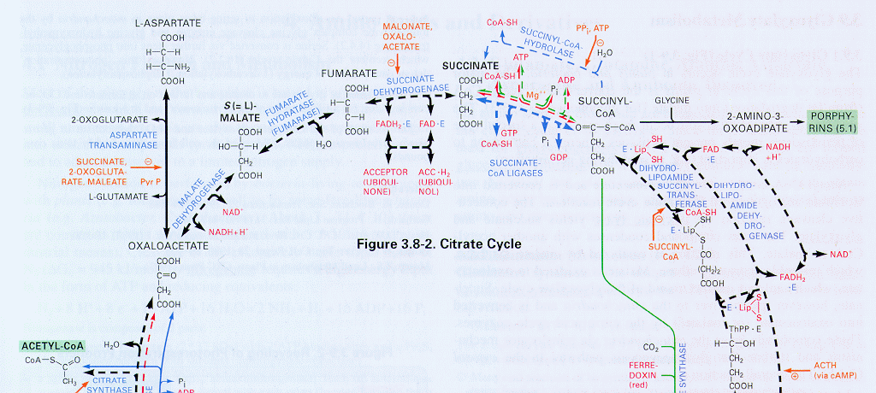
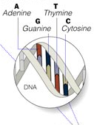
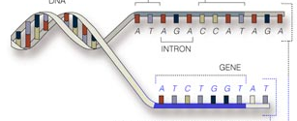
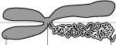
Bio-Map
GENOME
protein-gene interactions
PROTEOME
protein-protein interactions
METABOLISM
Bio-chemical reactions
Citrate Cycle

Slide 71
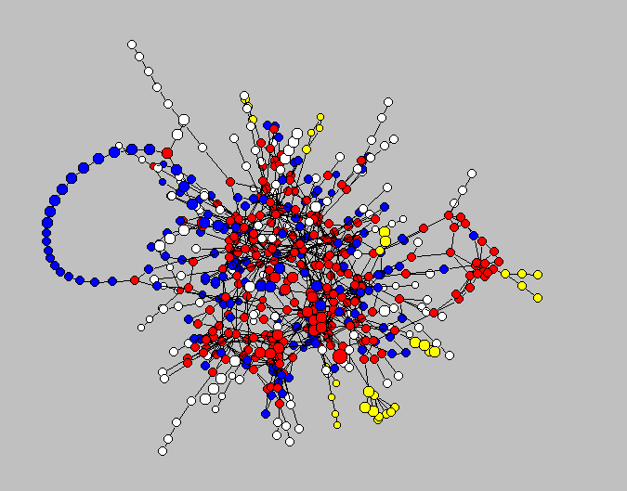
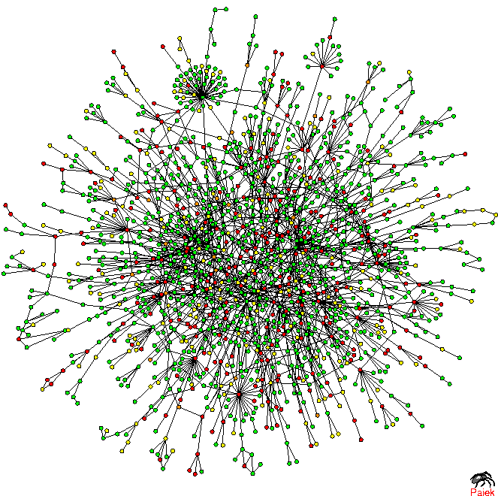
Metab-movie
Metabolic Network
Protein Interactions

Slide 72
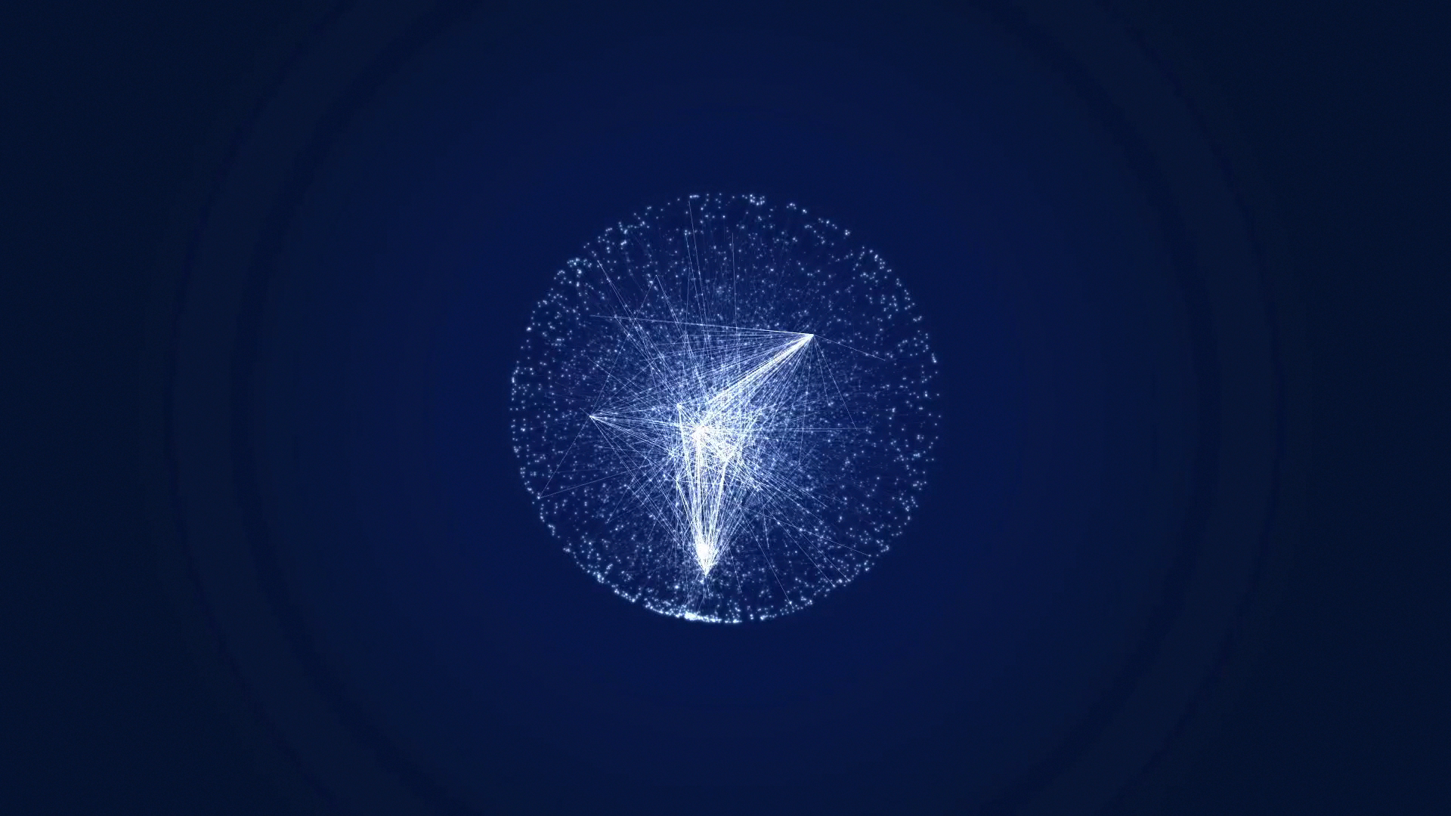
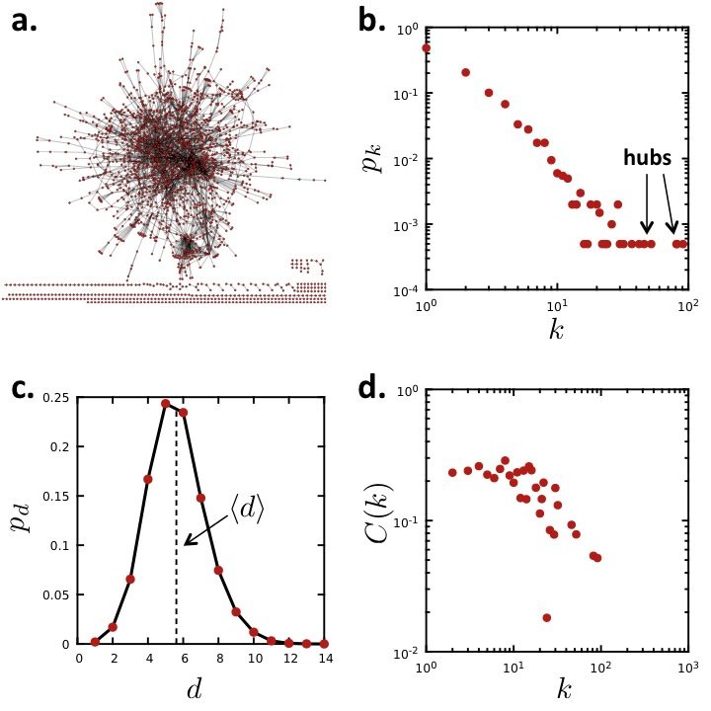
A CASE STUDY: PROTEIN-PROTEIN INTERACTION NETWORK
Undirected network
N=2,018 proteins as nodes
L=2,930 binding interactions as links.
Average degree <k>=2.90.
Not connected: 185 components
the largest (giant component) 1,647 nodes
Network Science: Graph Theory
Notes:
Let us discuss some of characteristics of this network, relying on the quantities we introduced so far. The undirected network has $N=2,018$ proteins as nodes and $L=2,930$ binding interactions as links.
Hence the average degree is $2.90$, suggesting that a typical protein interacts with approximately three other proteins. Yet, this number is somewhat misleading.
The breath first search algorithm will also convince us that the protein interaction network is not connected, but consists of 185 components, shown as isolated clusters in Fig. \ref{F-G-PPI-Overall}a. The largest, called the giant component, contains 1,647 of the 2,018 nodes; all other components are tiny compared to it. As we will see in the coming chapters, such fragmentation is common in model networks.
Finally, a visual inspection reveals an interesting pattern: hubs have a tendency to connect to small nodes, giving the network a hub and spoke character. This is a consequence of \textit{degree correlations}, reflecting the {\it dissasortative } nature of the protein interaction network. Degree correlations influence a number of network characteristics, from the spread of ideas and viruses in social networks to the number of driver nodes needed to control a network.

Slide 73
A CASE STUDY: PROTEIN-PROTEIN INTERACTION NETWORK
Undirected network
N=2,018 proteins as nodes
L=2,930 binding interactions as links.
Average degree <k>=2.90.
Not connected: 185 components
the largest (giant component) 1,647 nodes
Network Science: Graph Theory
Notes:
Let us discuss some of characteristics of this network, relying on the quantities we introduced so far. The undirected network has $N=2,018$ proteins as nodes and $L=2,930$ binding interactions as links.
Hence the average degree is $2.90$, suggesting that a typical protein interacts with approximately three other proteins. Yet, this number is somewhat misleading.
The breath first search algorithm will also convince us that the protein interaction network is not connected, but consists of 185 components, shown as isolated clusters in Fig. \ref{F-G-PPI-Overall}a. The largest, called the giant component, contains 1,647 of the 2,018 nodes; all other components are tiny compared to it. As we will see in the coming chapters, such fragmentation is common in model networks.
Finally, a visual inspection reveals an interesting pattern: hubs have a tendency to connect to small nodes, giving the network a hub and spoke character. This is a consequence of \textit{degree correlations}, reflecting the {\it dissasortative } nature of the protein interaction network. Degree correlations influence a number of network characteristics, from the spread of ideas and viruses in social networks to the number of driver nodes needed to control a network.

Slide 74
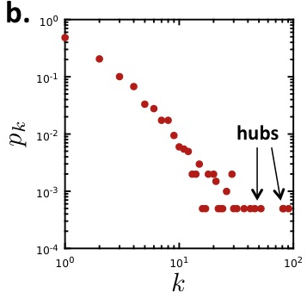
A CASE STUDY: PROTEIN-PROTEIN INTERACTION NETWORK
p_{k} is the probability that a node has degree k.
Nk = # nodes with degree k
p_{k} = Nk / N
Network Science: Graph Theory
Notes:
Indeed, the degree distribution $p_k$ shown in Fig. \ref{F-G-PPI-Overall}b indicates that the vast majority of nodes have only a few links. To be precise, in this network 69% of nodes have fewer than three links, i.e. for these $k < \langle k \rangle$. They coexist with a few highly connected nodes, or hubs, the largest having as many as 91 links. Such wide differences in node degrees is a consequence of the network's {\it scale-free property}, a property encountered in many real networks. We will see that the shape of the degree distribution determines a wide range of network properties, from a network's robustness to node failures to the spread of viruses.
If we use the breath-first-search algorithm, we can determine the network's diameter, finding $d_{max}=14$. We might be tempted to expect wide variations in $d$, as some nodes are close to each other, others, however, maybe quite far. The distance distribution (Fig. \ref{F-G-PPI-Overall}c), indicates otherwise: $p_d$ has a prominent peak around $\langle d \rangle=5.61$, indicating that most distances are rather short, being in the vicinity of $\langle d \rangle$. Also, $p_d$ decays fast for large $\langle d \rangle$, suggesting that large distances are essentially absent. These are manifestations of the {\it small world property}, another common feature of real networks, indicating that most nodes are close to each other.
The breath first search algorithm will also convince us that the protein interaction network is not connected, but consists of 185 components, shown as isolated clusters in Fig. \ref{F-G-PPI-Overall}a. The largest, called the giant component, contains 1,647 of the 2,018 nodes; all other components are tiny compared to it. As we will see in the coming chapters, such fragmentation is common in model networks.
The average clustering coefficient of the network is $\langle C \rangle=0.12$, which, as we will come to appreciate, is rather large, indicating a significant degree of local clustering in the network. A further caveat is provided by the dependence of the clustering coefficient on the node's degree, or the $C(k)$ function (Fig. \ref{F-G-PPI-Overall}d), which indicates that the clustering coefficient of the small nodes is significantly higher than the clustering coefficient of the hubs. This suggests that the small degree nodes tend to be part of dense local neighborhoods, while the neighborhood of the hubs is much more sparse. This is a consequence of {\it network hierarchy}, another widely shared network property.
Finally, a visual inspection reveals an interesting pattern: hubs have a tendency to connect to small nodes, giving the network a hub and spoke character. This is a consequence of \textit{degree correlations}, reflecting the {\it dissasortative } nature of the protein interaction network. Degree correlations influence a number of network characteristics, from the spread of ideas and viruses in social networks to the number of driver nodes needed to control a network.
Taken together, Fig. \ref{F-G-PPI-Overall} illustrates that the quantities we introduced in this chapter can help us diagnose several key properties of real networks. The purpose of the coming chapters is to study systematically these network characteristics, understanding what they tell us about the behavior of complex systems.

Slide 75
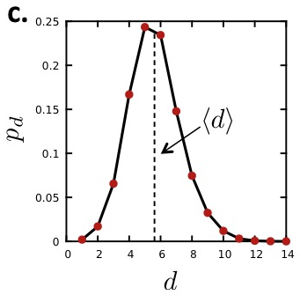
A CASE STUDY: PROTEIN-PROTEIN INTERACTION NETWORK
d_{max}=14
<d>=5.61
Network Science: Graph Theory
Notes:
If we use the breath-first-search algorithm, we can determine the network's diameter, finding $d_{max}=14$. We might be tempted to expect wide variations in $d$, as some nodes are close to each other, others, however, maybe quite far. The distance distribution (Fig. \ref{F-G-PPI-Overall}c), indicates otherwise: $p_d$ has a prominent peak around $\langle d \rangle=5.61$, indicating that most distances are rather short, being in the vicinity of $\langle d \rangle$. Also, $p_d$ decays fast for large $\langle d \rangle$, suggesting that large distances are essentially absent. These are manifestations of the {\it small world property}, another common feature of real networks, indicating that most nodes are close to each other.
The breath first search algorithm will also convince us that the protein interaction network is not connected, but consists of 185 components, shown as isolated clusters in Fig. \ref{F-G-PPI-Overall}a. The largest, called the giant component, contains 1,647 of the 2,018 nodes; all other components are tiny compared to it. As we will see in the coming chapters, such fragmentation is common in model networks.
The average clustering coefficient of the network is $\langle C \rangle=0.12$, which, as we will come to appreciate, is rather large, indicating a significant degree of local clustering in the network. A further caveat is provided by the dependence of the clustering coefficient on the node's degree, or the $C(k)$ function (Fig. \ref{F-G-PPI-Overall}d), which indicates that the clustering coefficient of the small nodes is significantly higher than the clustering coefficient of the hubs. This suggests that the small degree nodes tend to be part of dense local neighborhoods, while the neighborhood of the hubs is much more sparse. This is a consequence of {\it network hierarchy}, another widely shared network property.
Finally, a visual inspection reveals an interesting pattern: hubs have a tendency to connect to small nodes, giving the network a hub and spoke character. This is a consequence of \textit{degree correlations}, reflecting the {\it dissasortative } nature of the protein interaction network. Degree correlations influence a number of network characteristics, from the spread of ideas and viruses in social networks to the number of driver nodes needed to control a network.
Taken together, Fig. \ref{F-G-PPI-Overall} illustrates that the quantities we introduced in this chapter can help us diagnose several key properties of real networks. The purpose of the coming chapters is to study systematically these network characteristics, understanding what they tell us about the behavior of complex systems.

Slide 76
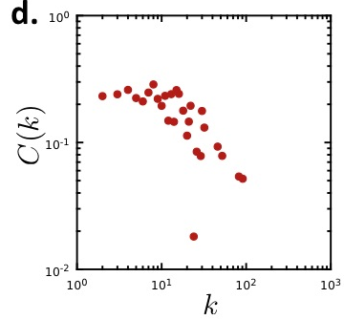
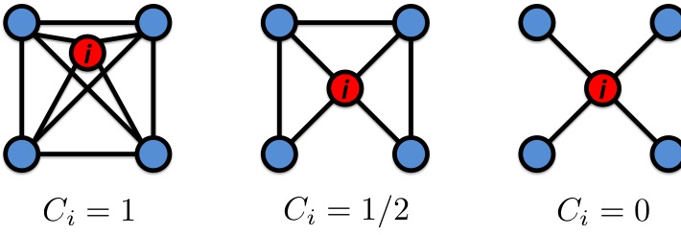
A CASE STUDY: PROTEIN-PROTEIN INTERACTION NETWORK
<C>=0.12
Network Science: Graph Theory
Notes:
The average clustering coefficient of the network is $\langle C \rangle=0.12$, which, as we will come to appreciate, is rather large, indicating a significant degree of local clustering in the network. A further caveat is provided by the dependence of the clustering coefficient on the node's degree, or the $C(k)$ function (Fig. \ref{F-G-PPI-Overall}d), which indicates that the clustering coefficient of the small nodes is significantly higher than the clustering coefficient of the hubs. This suggests that the small degree nodes tend to be part of dense local neighborhoods, while the neighborhood of the hubs is much more sparse. This is a consequence of {\it network hierarchy}, another widely shared network property.
Taken together, Fig. \ref{F-G-PPI-Overall} illustrates that the quantities we introduced in this chapter can help us diagnose several key properties of real networks. The purpose of the coming chapters is to study systematically these network characteristics, understanding what they tell us about the behavior of complex systems.

Slide 77
Class
CLASS INFORMATION
Network Science: Introduction
Notes:
Nowhere is the impact of network thinking more evident than in the scientific community. The most prominent scientific journals, from Nature and Science to Cell and PNAS, have devoted special issues, reviews, or editorials address- ing the impact of networks on various topics from biology to social sciences. During the past decade, each year several dozen international conferences, workshops, summer and winter schools have focused exclusively on network sci- ence. A successful network science meeting series, called NetSci, attracts the field’s practitioners since 2005. Several general-interest books, making the bestseller lists in many countries, have brought network science to the public. Most major universities offer network science courses, attracting a diverse student body.

Slide 78
Classes
Classes: 5:30-7:30pm
Always at the CCNR,
DANA building 57, 5th floor*
*unless a different location is announced (during classes, via email)

Slide 79
Course material and information
Webpage: http://barabasilab.neu.edu/courses/phys5116/
Syllabus, Agenda
Important links (visualization programs, wikis, glossary...)
Homework assignments
Slides
Our emails
The course outline
OpenRev platform: http://www.openrev.org/group/complex-networks
Updated book chapters
Google group mailing list for the class (and invite everyone)

Slide 80

Webpage
Slides as well as syllabus, agenda and assignments will be posted here

Slide 81
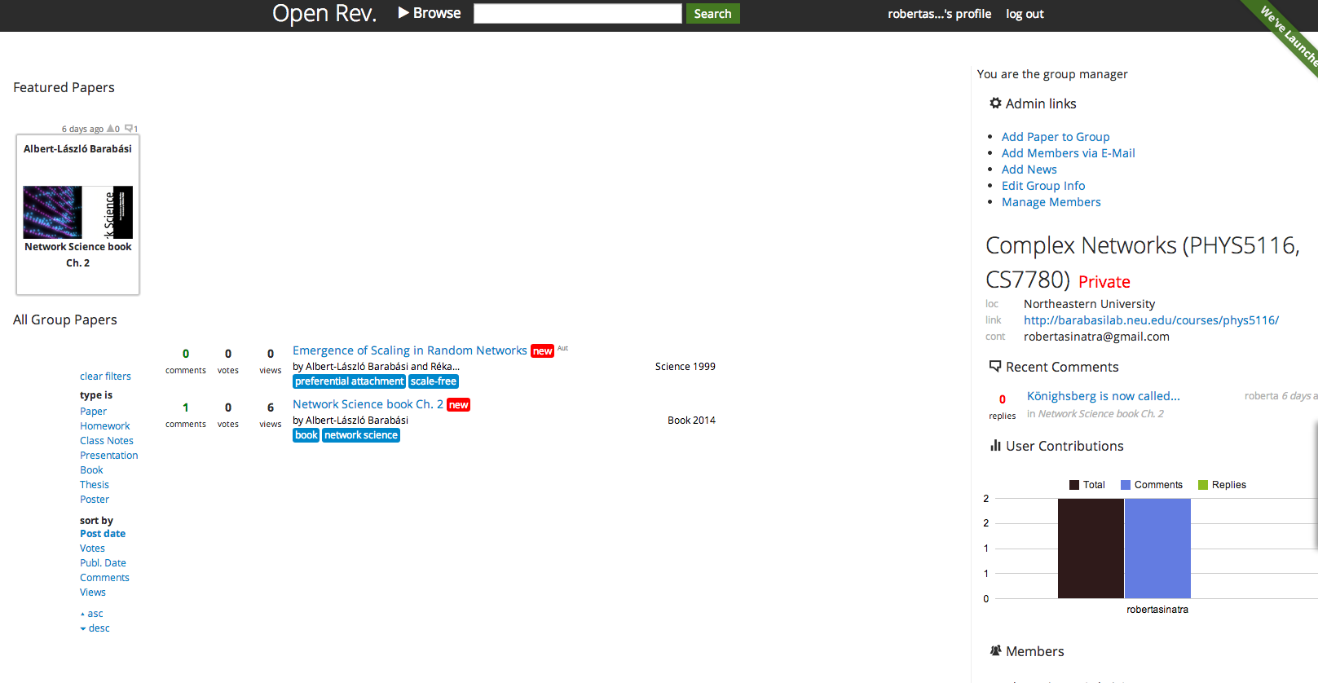
OpenRev
Update book chapters will be posted here before or soon after the lesson
Notes:
Show briefly how the website works

Slide 82
OpenRev
Important papers will be also posted here

Slide 83
OpenRev
You can write comments on the PDFs (will be seen by everyone)

Slide 84
Course material and information
http://barabasilab.neu.edu/courses/phys5116/
Important links (visualization programs, wikis, glossary...)
Homework assignments
Our email
Updates and messages
Syllabus
The course outline
Much much more
You can contact us at: r.sinatra@neu.edu, barabasi@gmail.com
We will also create a google mailing list for the class, and invite everyone.

Slide 85
Course overview
 |  | Monday |  | Wednesday |  | Friday | Comments | # lessons | Extra lessons
Sep. 1 - 5 | - | No classes (Labor day) | L. | Chapter 1: Introduction | L. | Chapter 2: Graph Theory |  | 3 | : +1
Sep. 7- 12 | L. | Chapter 3: Random Networks | L. | Chapter 4: The scale-free property | L. | Chapter 5: The Barabási-Albert model |  | 6 | : +2
Sep. 14 - 19 | L. | Chapter 6: Evolving Networks | L. | Chapter 6: Evolving Networks | L. | Preliminary Project Presentation |  | 9 | : +3
Sep. 21 - 26 | - | --- | - | --- |  |  |  | 9 | : +1
Sept. 28 - Oct. 3 | R. | Hands on: graph representation, binning | R. | Hands on: Gephi and Networkx |  |  | Hand-in assignments 1 | 11 | : +1
Oct. 6 - 10 | R. | Small-world networks | - | --- |  |  |  | 12 | 0
Oct. 13 - 17 | - | No classes (Columbus Day) | R. | Cycles and motifs |  |  | Hand-in assignments 2 | 13 | 0
Oct. 20 - 24 | L. | Chapter 9: Communities | L. | Chapter 7: Degree correlations |  |  |  | 15 | 0
Oct. 27 - 31 | L. | Chapter 8: Network robustness | L.-R. | Movie night |  |  |  | 16 | -1
Nov. 3 - 7 | L. | Chapter 10: Spreading phenomena |  | Guest speaker: Joerg Menche |  | Guest speaker (at noon): Michael Kearns | Hand-in assignments 3 | 19 | 0
Nov. 10 - 14 | L. | Weighted networks |  | Guest speaker: Yang-Yu Liu |  |  |  | 21 | 0
Nov. 17 - 21 | R. | Dynamics on networks (Random walks and page-rank) |  | Guest |  |  | Wikipedia write-up due | 23 | 0
Nov. 24 - 28 | R. | Open door class | - | No classes (Thanksgiving recess) |  |  |  | 24 | 0
Dec. 1 - 5 | L.-R. | TBA | L.-R. | Project Presentation (non-Network Science students) |  |  |  | 26 | 0
Dec. 8 - 12 | L.-R. | Project Presentation (PhD in Network Science) | Exam week

Slide 86
Course overview
 |  | Monday |  | Wednesday |  | Friday | Comments | # lessons | Extra lessons
Sep. 1 - 5 | - | No classes (Labor day) | L. | Chapter 1: Introduction | L. | Chapter 2: Graph Theory |  | 3 | : +1
Sep. 7- 12 | L. | Chapter 3: Random Networks | L. | Chapter 4: The scale-free property | L. | Chapter 5: The Barabási-Albert model |  | 6 | : +2
Sep. 14 - 19 | L. | Chapter 6: Evolving Networks | L. | Chapter 6: Evolving Networks | L. | Preliminary Project Presentation |  | 9 | : +3
Sep. 21 - 26 | - | --- (ECCS) | - | --- (ECCS) |  |  |  | 9 | : +1
Highlights:
15 min discussion on projects at the end of each class
Preliminary Project presentations on Friday Sep. 19th (No grading, only feedback)
5 min/max 5 slides. Print-out + email
Hand-out of first assignment (due on October 3rd)
No classes on the week Sep. 21-26

Slide 87
Course overview
Sept. 28 - Oct. 3 | R. | Hands on: graph representation, binning | R. | Hands on: Gephi and Networkx |  |  | Hand-in assignments 1 | 11 | : +1
Oct. 6 - 10 | R. | Small-world networks | - | --- |  |  |  | 12 | 0
Oct. 13 - 17 | - | No classes (Columbus Day) | R. | Cycles and motifs |  |  | Hand-in assignments 2 | 13 | 0
Highlights:
Bring a laptop for the class on September 30th
Hand-in assignment by Friday, October 3rd, 6pm
Hand-out of second assignment, hand-in by Friday, October 17th, 6pm
Bring the assignments here to the CCNR, and hand it to Roberta. If not in the office, slide it under the door of the room at the entrance

Slide 88
Course overview
Oct. 20 - 24 | L. | Chapter 9: Communities | L. | Chapter 7: Degree correlations |  |  |  | 15 | 0
Oct. 27 - 31 | L. | Chapter 8: Network robustness | L.-R. | Movie night |  |  |  | 16 | -1
Nov. 3 - 7 | L. | Chapter 10: Spreading phenomena |  | Guest speaker: Joerg Menche |  | Guest speaker (at noon): Michael Kearns | Hand-in assignments 3 | 19 | 0
Nov. 10 - 14 | L. | Weighted networks |  | Guest speaker: Yang-Yu Liu |  |  |  | 21 | 0
Highlights:
Movie Night: Connected, by Annamaria Talas. Probably later than 5.30pm (will be announced)
Hand-out of third assignment, hand-in by Friday, November 7th, 6pm
Lectures from guests on their research

Slide 89
Course overview
Nov. 17 - 21 | R. | Dynamics on networks (Random walks and page-rank) |  | Guest |  |  | Wikipedia write-up due | 23 | 0
Nov. 24 - 28 | R. | Open door class | - | No classes (Thanksgiving recess) |  |  |  | 24 | 0
Highlights:
Wikipedia write-up due by Friday, November 21st, 6pm. Email with link to wikipedia article, but also print-out and hand-in.
Open door class for questions or assistance about the final projects

Slide 90
Course overview
Dec. 1 - 5 | L.-R. | TBA | L.-R. | Project Presentation (non-Network Science students) |  |  |  | 26 | 0
Dec. 8 - 12 | L.-R. | Project Presentation (PhD in Network Science) | Exam week
Highlights:
Project presentations!
First day for all non-network science students
Second day for network science grad students
Send slides via email

Slide 91
Grading
#3 Written assignments (15% each, Total 45%)
(bring them to the CCNR and hand it directly to Roberta. If not in the office, slide it under the first door)
Wikipedia write-up (15%)
Projects (40%)

Slide 92
Wiki project recommendation
Select a keyword related to network science and check if there is a page for it in Wikipedia. “Related” is defined widely– you can talk about a technical measure related to networks (like degree distribution), a network-related phenomena (terrorist networks), the use of networks (network in finance), or anything else that you can convincingly relate to networks (Bacon number, Erdös number, Six degrees, actor network, networking).
If the page exists already, go to point 1, and start over. If it does not exist, plan to write a page on it. You are not expected to generate original results on your topic. The best is to identify 2-5 sources on the subject (research papers, books, etc.) and write a succinct, self-contained Wiki-style summary, with references, graphs, tables, images, photos, whichever is appropriate. You will need to observe Wikipedia’s copyright expectations for all visual material you add.
Upload your page on Wiki (actually, develop it there) and send us the link when you are done (but certainly by the due date). To be on the safe side, also print it out and hand it in. We will grade you how on understandable, pertinent and self-contained is the content, and your ability to link it to networks.
You will need to signup in wikipedia!
(anonymous editing not allowed)

Slide 93
Final project
The final project accounts for 40% of the final grade.
Collection and analysis of real network data
The project will be carried out in inter-program/year pairs (e.g. physics and bio). Undergrad students have to pair up with grad students.
Network science students carry on individual projects
Preliminary project presentation – September 19th. 5min/5 slides from each group
Final project presentation – December 3rd (all non-network science students) and December 8th (Network science grad students). 15 min/15 slides from each group

Slide 94
Preliminary project
5 slides
Discuss:
What are your nodes and links
How will you collect the data
Expected size of the network (# nodes, # links)
What questions you plan to ask (they may change as we move
along with the class).
Why do we care about the network you plan to study.
Network Science: Evolving Network Models February 14, 2011

Slide 95
Final project guidelines
Measure: N(t), L(t) [t- time if you have a time dependent system); P(k) (degree distribution); <l> average path length; C (clustering coefficient), C_{rand,} C(k); Visualization/communities; P(w) if you have a weighted network; networ robustness (if appropriate); spreading (if appropriate).
It is not sufficient to measure things– you need to discuss the insights they offer:
What did you learn from each quantity you measured?
What was your expectation?
How do the results compare to your expectations?
Time frame will be strictly enforced. Approx 12min + 3 min questions;
No need to write a report—you will hand in the presentation.
Send us an email with names/titles/program.
Come earlier and try out your slides with the projector. Show an entry of the data source—just to have a sense of how the source looks like. On the slide, give your program/name.
Grading criteria:
Use of network tools (completeness/correctness);
Ability to extract information/insights from your data using the network tools;
Overall quality of the project/presentation.

